Slide 1
DATA-54000 Large Scale Data Storage Week 7
Prof. Manoj M. Bhat
Email : bhatma@lewisu.edu

Slide 2
This week…
This week we’ll learn about ways to optimize the storage of data using compression and data formats
This will translate into lower cost for the storage on disks or in S3
Gain a performance boost
For the assignment, you will use either AWS tools or Apache Spark in bitnami hadoop

Slide 3
Data Compression

Slide 4
What and why?
What:
Process of reducing the size of a data file
Can be lossy or lossless
Lossy : reduces bits by removing unnecessary or less important information
Lossless : no information is lost
Why
Save time when transferring data over the network
To get around the email file limits when sending file attachments
Reduce storage space consumed by files

Slide 5
Data file compression formats
Lossy compression is used for images, video and audio
MP3, JPEG, TIFF, GIF, BMP formats
Lossless is used when you don’t want to lose information
LZO, LZ4, Snappy etc..
Gzip, Lzip, Bzip2, 7zip etc..
File extensions: .zip, .bz2, .7z, .gz2, .gz,
File archives - Combine many files into one file
Typical extensions : .jar, .tar, .war, .deb, .rpm, .iso etc..
‘tarball’ – tar file

Slide 6
Performance considerations
Compression and decompression requires computing resources
Choosing the right data compression algorithm requires knowledge and some trial-and-error (evaluation)
Key question to ask is whether you want to process compressed files in parallel on many servers or on just one server?

Slide 7
Big data compression
Data processing jobs are usually I/O bound
Compressed data can save storage space and speed up data transfers across the network
Splittability of the compressed data must be considered
Can the compressed file be split and operated upon independently on any server?
Every compressed split of the file can be uncompressed and processed independently.
Parallel processing is therefore possible
If not splittable (snappy), then only server is doing all the work
100 node cluster: 1 node working, 99 nodes are idle
If I use bzip2, then all 100 nodes are processing the data

Slide 8
Data Compression algorithms
Format | Algorithm | File extension | Splittable?
GZIP | Deflate | .gz | No
BZIP2 | Bzip2 | .bz2 | Yes
LZO | LZO | .lzo | Yes
Snappy | Snappy | .snappy | No
LZ4 | Kind of LZ77 | .lz4 | No

Slide 9
Storage formats

Slide 10
Storage formats
The following options are available for big-data
Text
Apache Avro
Apache Parquet
Apache Optimized Row Columnar (ORC)
Regular binary formats such as .exe, .pdf etc.. are not suitable since they cannot be split for distributed processing

Slide 11
Text
Usually in the following format :
CSV ( comma separated values)
TSV ( tab separated values)
JSON ( Javascript object notation)
Convenient to use and exchange with other applications
Human readable and parseable
Data store is bulky and not as efficient to query
Files are splittable

Slide 12
Avro
Widely used as a serialization platform
Row-based, offers a compact and fast binary format
Schema is encoded on the file
PlayerID, Name, BirthYear
111, Joe, 1961
Files are splittable because schema goes with the file

Slide 13
Parquet
Developed by Cloudera and now open-source (parquet.apache.org)
Splittable, Columnar binary file format
Efficient in terms of disk I/O when specific columns need to be queried
Integrated with Hadoop ecosystem. Can be read/written by Hive, Spark, MapReduce
Data starts off as CSV, gets converted into parquet

Slide 14
ORC
Optimized Row Columnar
Developed by Hortonworks and then open-sourced at Apache.org
Stores collections of rows and within the collection the row data is stored in columnar format
Splittable
Binary format
Cloudera has standardized on ORC

Slide 15
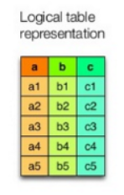


What is columnar data?
All values of a column are stored together
Limits I/Os to the data needed
Compresses better
In the pictures below, ‘a’, ‘b’, and ‘c’ are columns in a table
A1, b1, c1 will be row #1 of the table

Slide 16
Which data format to choose?
For writing:
Text is bulky and inefficient but easily readable
Parquet and ORC need additional parsing to format the data which increases overall read time
Cannot use vi, notepad, textpad to create ORC/Parquet
For reading:
Text is really slow to read
For orc/parquet, the tools/application must be able to read it out-of-the box
For column specific queries, use columnar format like Parquet or ORC

Slide 17
Which format to choose?
Start with a text format and develop your programs/processes using smaller data sets
Analyze the query patterns
Are you using just a few columns? Choose a columnar format
Do you need ACID compliance? Choose ORC
Save space by adding compression to the data format
Parquet supports snappy, gzip
ORC supports snappy
Consider schema evolution when choosing the format

Slide 18
Schema evolution
Schema is a structure of a record
Schema evolution : Changes to the data structure such as adding, renaming or removing columns
Version1:
PlayerID, Name, birthYear
Version 1.1
PlayerID, Name, birthYear, birthCity
Data formats that support schema evolution are:
Avro
Parquet : can only add columns at the end
ORC

Slide 19
How to create?
If you have data in text format and need to convert to other formats, your options are:
Write programs using libraries
Use Apache Spark functions to read/write data in various formats
Use Hadoop Hive’s SQL statements to save data in various formats
Use AWS Glue

Slide 20
Using Spark
Spark provides several functions to save data into different formats. Example,
CSV:
Read: spark.read.csv(“/tmp/xyz.csv”)
Write: df.write.csv(“/tmp/xyz.csv”)
Parquet:
Read: spark.read.parquet(“/tmp/xzy.parquet”)
Write : df.write.parquet(“/tmp/xyz.parquet”)
ORC
Read : df.read.orc(“/tmp/xyz.orc”)
Write: df.write.orc(“/tmp/xyz.orc”)

Slide 21
Using Hive/Impala for conversion
Use the “create table” command to create a table with a particular format. Ex.
create table airline_data_text ( year int, ……) stored as ORC;
create table airline_data_orc ( year int, ……) stored as text;
create table airline_data_parq( year int, ……) stored as parquet;

Slide 22
Using AWS Glue
AWS Glue is a (“serverless”) managed ETL tool
Consists of metadata repository, ETL engine, Scheduler
The metadata repository contains information about your source and target data
‘Database’ and ‘Table’ to organize the information
Steps
First use crawlers to create database and tables by analyzing the source data
Define ETL using the AWS Glue Studio user interface
Run the ETL jobs to do the data load, transformation and writing to the target

Slide 23
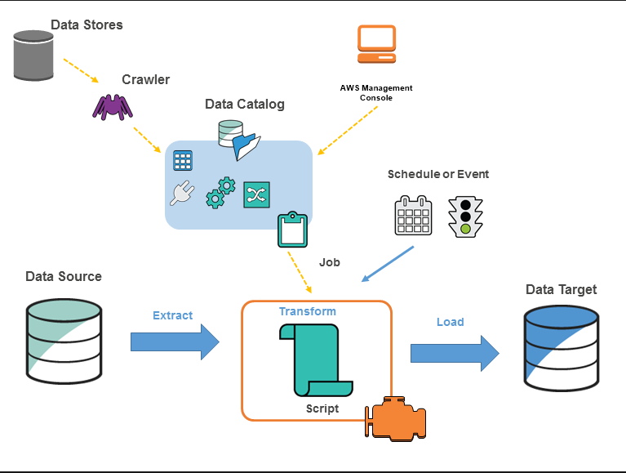
AWS Glue

Slide 24
End of presentation

